Slide 1



ARM Microprocessor - Interrupts and Timers
Sewmehon E.

Slide 2
CONTENTS
1. Introduction
2. Interrupts
3. Timers
4. Conclusion

Slide 3

Introduction
The ARM microprocessor includes crucial functionalities such as interrupts and timers, which help manage real-time operations efficiently. This document provides an in-depth explanation of these concepts, their functionalities, and their applications in embedded systems.

Slide 4

Interrupts
An interrupt is a signal sent to the processor to notify it of an event requiring immediate attention. The processor temporarily halts execution, invokes an Interrupt Service Routine (ISR) to handle the event, and resumes its prior execution once the event is handled.

Slide 5






Interrupt States
Interrupts can exist in the following three states:
Inactive: No conditions have been met to generate an interrupt.
Pending: Conditions for generating the interrupt are met, but ISR has not been executed yet.
Active: The ISR is currently executing the interrupt.
Once the event is handled, the interrupt state returns to inactive.

Slide 6

Interrupt Components
The hardware implementation of interrupts involves multiple components:
Interrupt Controller: A peripheral that manages the interrupts.
Interrupt Source: Any peripheral (ADC, Timer, GPIO, UART) that triggers an interrupt.
Interrupt Trigger: The hardware event that generates the interrupt via an electrical signal.
Interrupt Vector Table (IVT): A table storing the addresses of all ISRs in memory.
Interrupt Masking: Allows disabling of interrupts selectively to avoid conflicts.

Slide 7


Interrupt Flags and Priorities
Interrupt controllers utilize flags to signal event occurrences:
Interrupt Enable Flag: Determines whether the processor acknowledges and services an interrupt.
Priority Levels:
Interrupts are assigned numerical priorities.
Higher-priority interrupts are serviced before lower-priority ones.
A high-priority interrupt can preempt a low-priority interrupt's execution.
Nested Vector Interrupt Controller (NVIC): Manages prioritization and nesting of interrupts in ARM microcontrollers.

Slide 8







Software Handling of Interrupts
When an interrupt occurs, the following steps are executed:
The current state of the CPU is saved.
The ISR corresponding to the interrupt is fetched from the Interrupt Vector Table.
The ISR is executed to handle the event.
Once execution is complete, the saved CPU state is restored.
The program resumes from where it was interrupted.

Slide 9
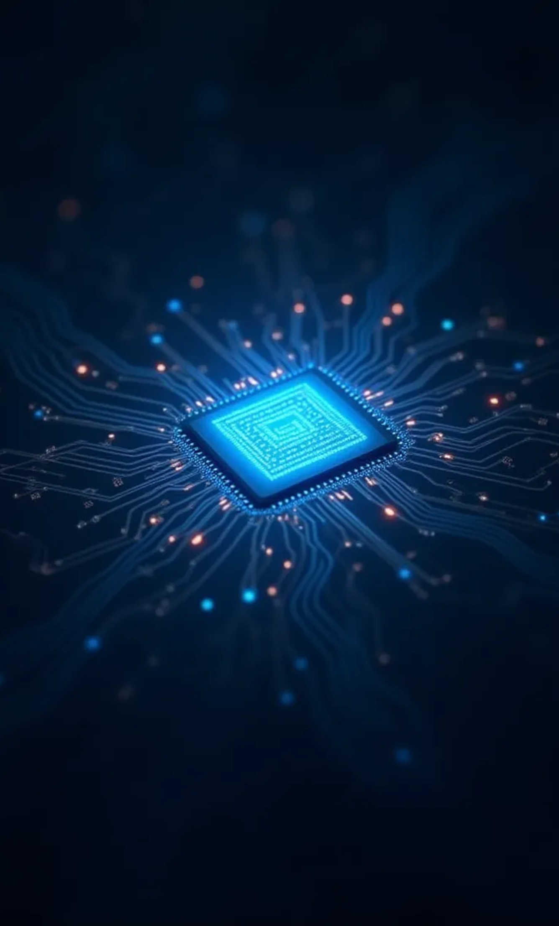
Applications of Interrupts
Real-time processing: Used in critical real-time applications such as robotics and automation.
Event-driven execution: Improves efficiency by responding to external triggers instead of continuous polling.
Power-saving: Enables processors to remain in low-power mode and wake up only when an interrupt occurs.

Slide 10

Timers
A timer is a hardware peripheral used to measure time and generate precise delays. ARM-based microcontrollers, such as MSP432, feature Timer32, a 32-bit timer.

Slide 11


Timer Functions
1
Timers perform the following key functions:
2
Generating time delays.
3
Counting external events.
4
Operating independently of the CPU.
5
Scheduling periodic tasks in real-time operating systems (RTOS).

Slide 12






Timer Operation Modes
Timers operate in two main modes:
One-Shot Mode: The timer counts down once and stops.
Periodic Mode: The timer reloads its count value after reaching zero and continues running.
PWM (Pulse Width Modulation) Mode: Used for controlling motors and LED brightness.
Capture Mode: Captures external events such as button presses.

Slide 13

Timer Components
Timers consist of:
Counter Register: Stores the countdown value.
Clock Source: Provides the timing reference.
Compare Register: Holds the predefined value to trigger an event.
Flag Register: Signals when the timer reaches the predefined value.
Prescaler: Divides the input clock frequency to achieve longer delays.

Slide 14

Timer Example Applications(1)
1
Speed Calculation: An IR sensor connected to a vehicle's wheel generates pulses. A counter counts these pulses to measure speed.
2
Delay Generation:
3
Given an 8-bit timer with a frequency of 40Hz, a required delay of 100ms can be achieved by setting the compare register to 4.
4
Since 1 pulse = 25ms, when the counter reaches 4, 100ms delay is achieved.
5
PWM Signal Generation:
6
Timers generate PWM signals to control motor speed or LED intensity.

Slide 15
Timer Example Applications(2)
1
Example: A 50% duty cycle PWM signal means the output is ON for half the period and OFF for the other half.
2
Real-Time Clock (RTC) Implementation: Timers help in implementing an RTC by keeping track of seconds, minutes, and hours.

Slide 16

Conclusion
Interrupts and timers are fundamental in embedded systems, enabling efficient handling of real-time events. Proper understanding of these components ensures optimized performance of microcontroller-based applications. The ARM microcontroller's NVIC system enhances interrupt handling, while timers provide critical functionality for event scheduling, delay generation, and signal processing.

Slide 17
Thank You

